Slide 1
House Price Surface of Glasgow
Dr Jon Minton
30 March 2015

Slide 2
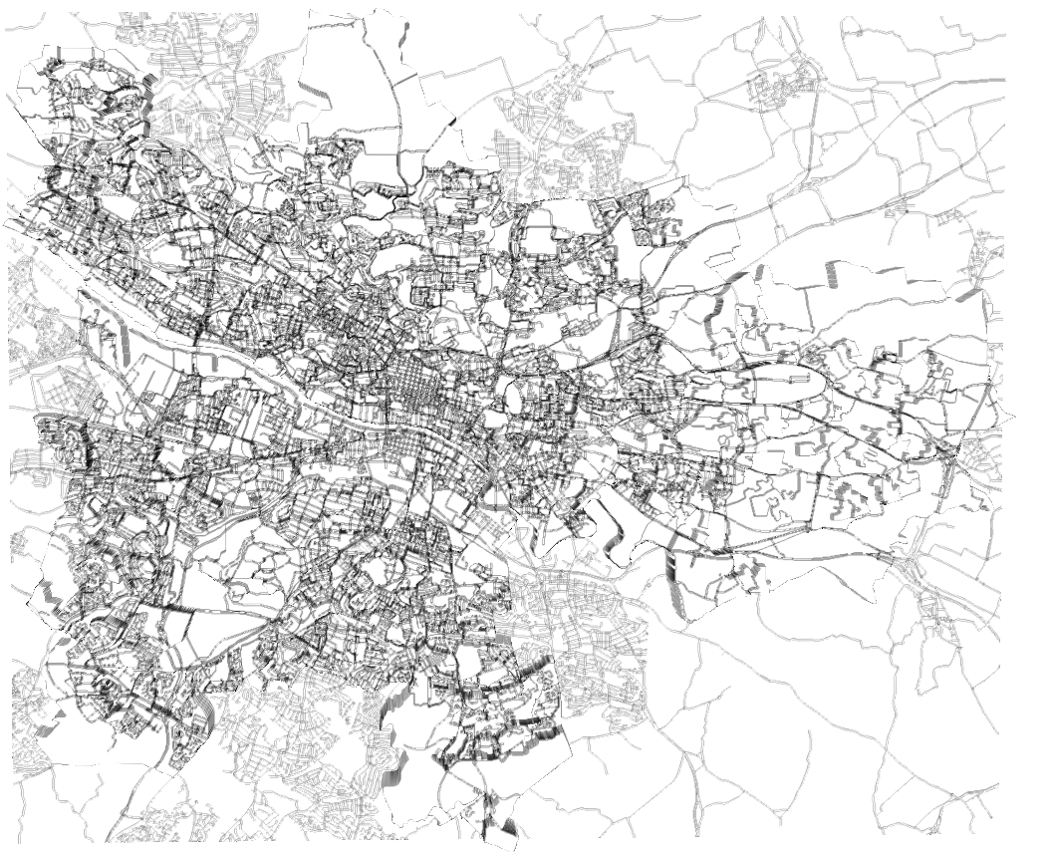
From above

Slide 3
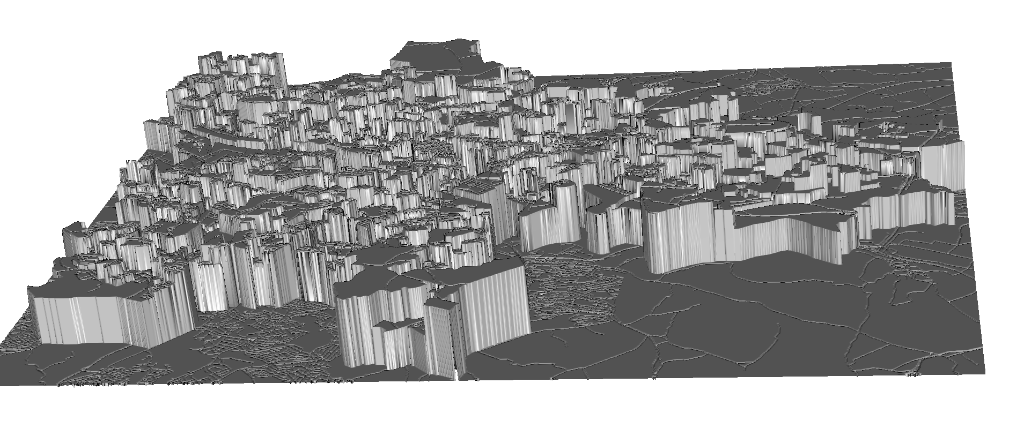
Looking north

Slide 4
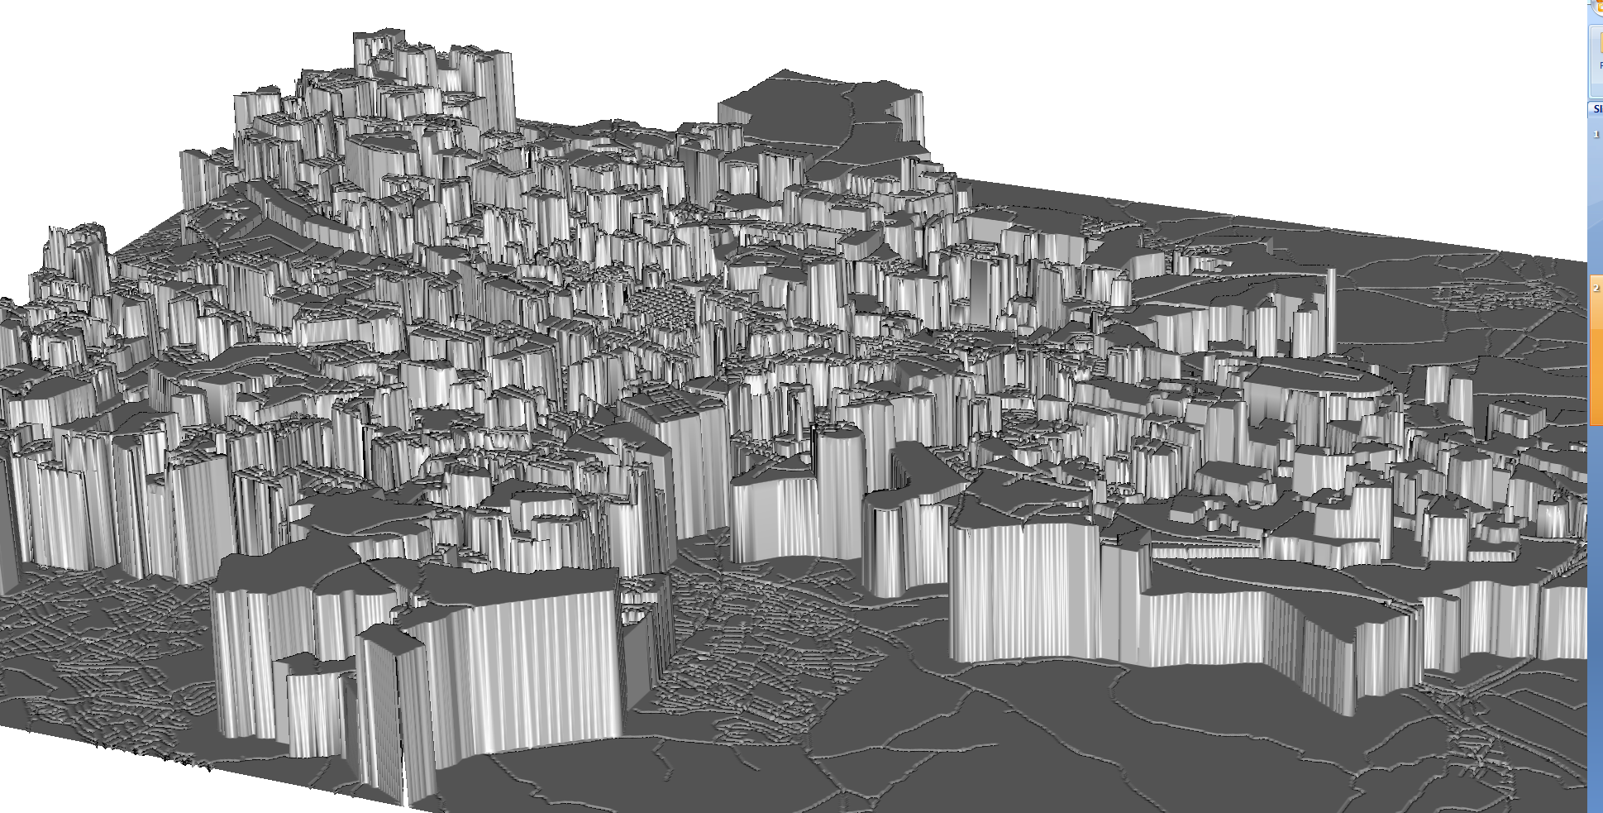
Looking north-west

Slide 5
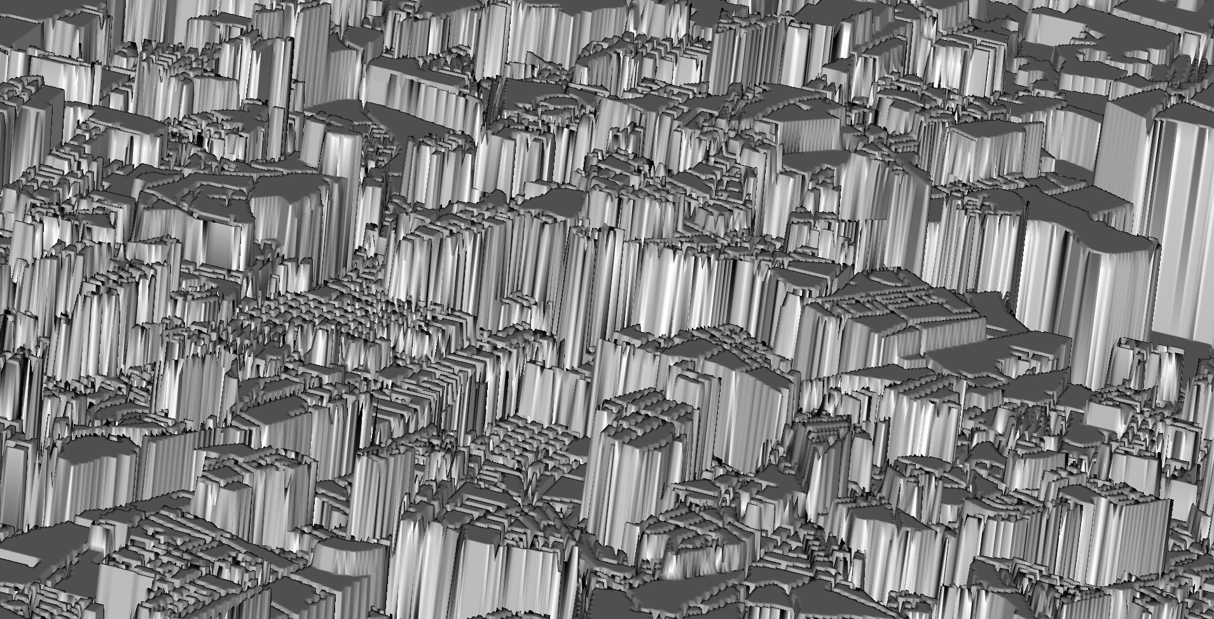
Closer up, looking east

